Slide 1
Critique for AAA
Team Next Door

Slide 2
Concepts concerns
Donor
Alumnus vs Donor: synonymous or subsets?
Update
Update and Advice: difference from normal messages?
Notes:
Alumnus vs donor: are alumnus and donor synonymous or are donors subsets of alumnus?
Update and advice: what makes them novel and distinguishable concepts? What makes them different from normal messages?

Slide 3
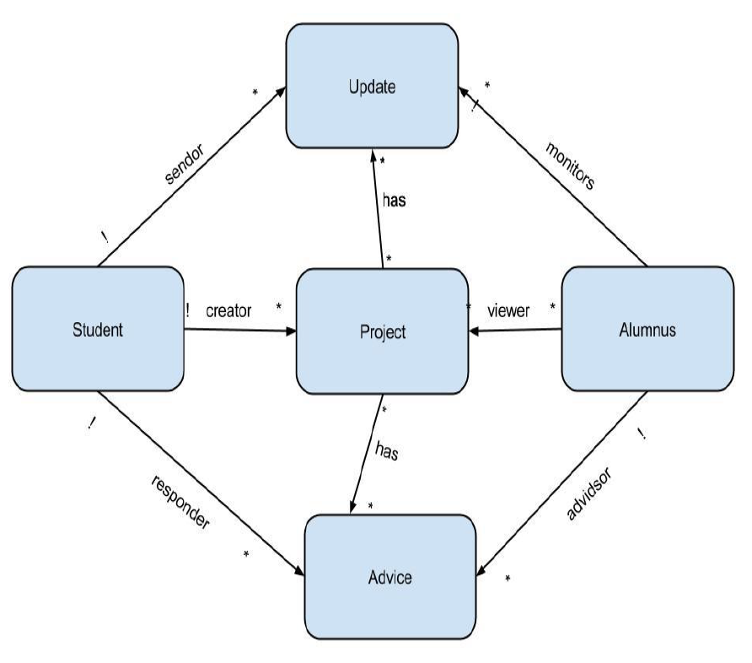
Data Model Concerns
Stronger viewer relationship
alumnus -> project
Redundant monitor relationship
alumnus -> update
Multiplicity of relationship
project -> update
Notes:
Consider making the viewer relationship between alumnus and project stronger
alum not only views a project, but also sponsors
if viewing is a relationship, should include a history set of all projects viewed?
Monitor relationship between alumnus and update seems redundant
alum can get update through project
Update should be tied to a single project, not zero or more?

Slide 4
Risk Assessment
Unreliable students and/or alumni
How do you plan to handle unreliable or irresponsible students and alumni? Is there a peer review system where students can evaluate alumni and vice versa?
MIT Mailing Lists
How will you prevent the same person receiving additional funding under an alias?

